Slide 1

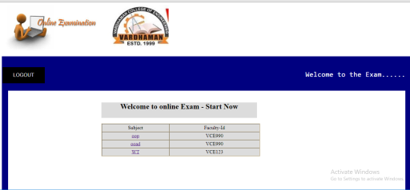
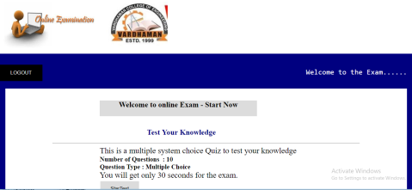
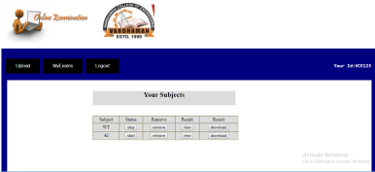
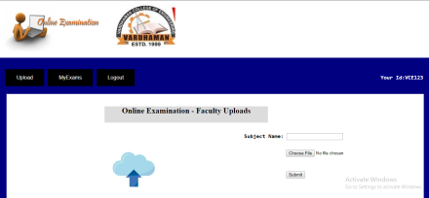
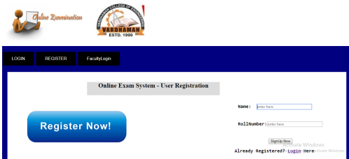
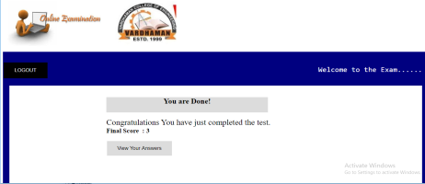
Day to Day Evaluation
-
Examination is a test not just for the person who gives the exams but also for the management and teacher who arranges the exams as they have a big responsibility to make sure everything goes well.
Online Examination System removes most of the drawback that was in the traditional examination system like students can give exams from anywhere around the globe just a computer with internet connection needed. Also the exams results can be calculated automatically just at the end of exams. It also minimizes the error in calculating results which humans do most of the time. It has a two section admin and exam givers.
Online Exams provide flexibility and security for question paper as each student gets random questions.
Online examination software is easy to use, loads faster, and can be customized to suit the specified needs of an organization. By Choosing appropriate organisation you can use perfect online software for Exam.
Online Examination Results are instant and accurate
Software requirements for Online Examination System Project
Online Examination System is made with PHP, Mysql. It will run on Apache Server. Check below for details.
Operating System – Windows/Linux
Programming langauge – PHP 5,JAVASCRIPT,JSON,Html,Css
Database Server – Mysql 5.0 or higher
Web Server – Apache 2.4.7 or higher
Features provided in this project.
The features in this projects are given below.
Client side validation using javascript.
Passwords are generated radomly.
The faculty can add/edit/delete/view the Subjects.
The faculty can view the user list and basic details who gives exams.
The faculty can view exams results of each individual user.
New User has to sign up with the system to give examination

